Slide 1


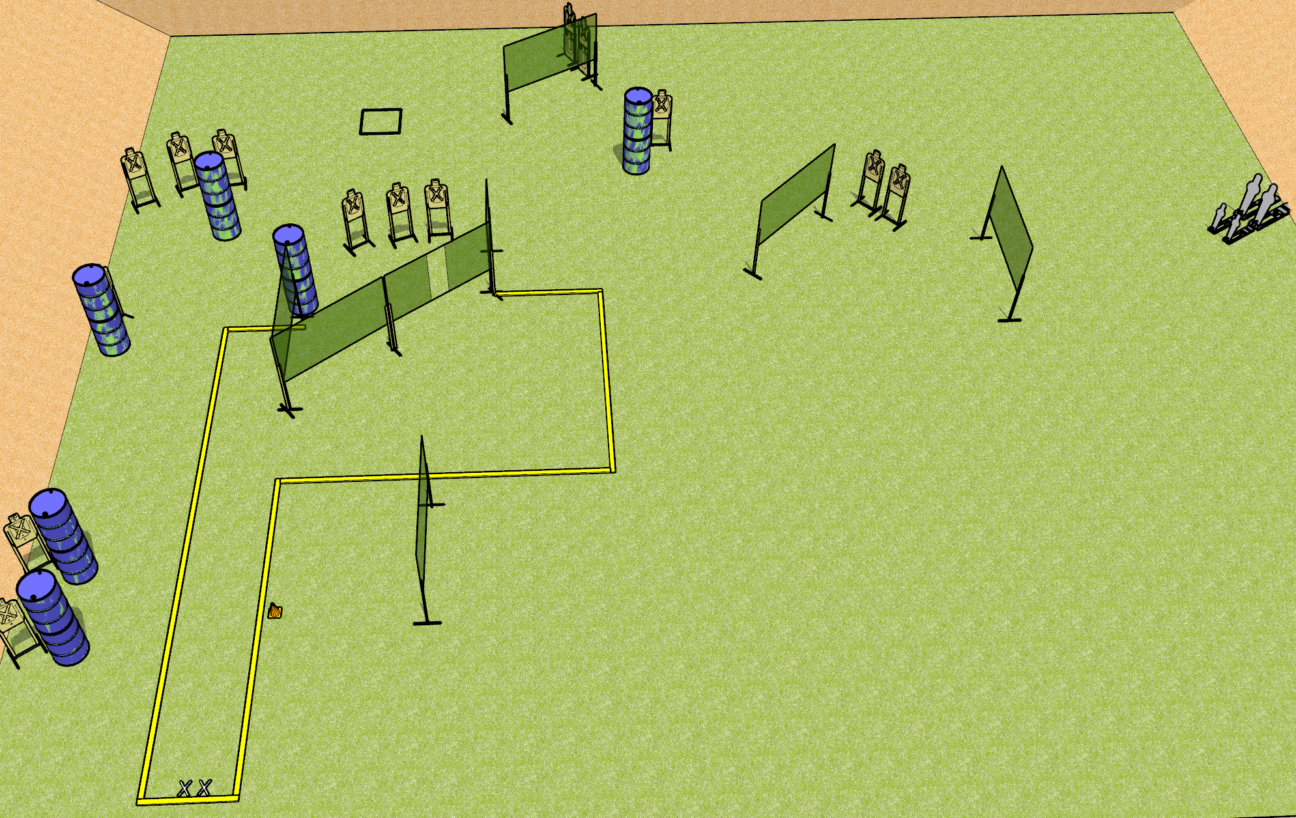
 | Dothan Gun Club – USPSA Match Gone Crazy Course Designer : Drew Coleman
START POSITION : Standing with both feet on X’s, facing uprange. PCC buttstock on belt pointed generally at cone
GUN READY CONDITION : Pistol loaded and holstered. PCC loaded, safety on, buttstock on belt pointed generally at cone |  | SCORING: Comstock, 36 rounds TARGETS: 16 paper, 4 Steel SCORED HITS: Best 2 on paper, steel until down START-STOP: Audible, last shot RULES:
STAGE PROCEDURE: Engage targets as they become available from within the fault lines

